Slide 1
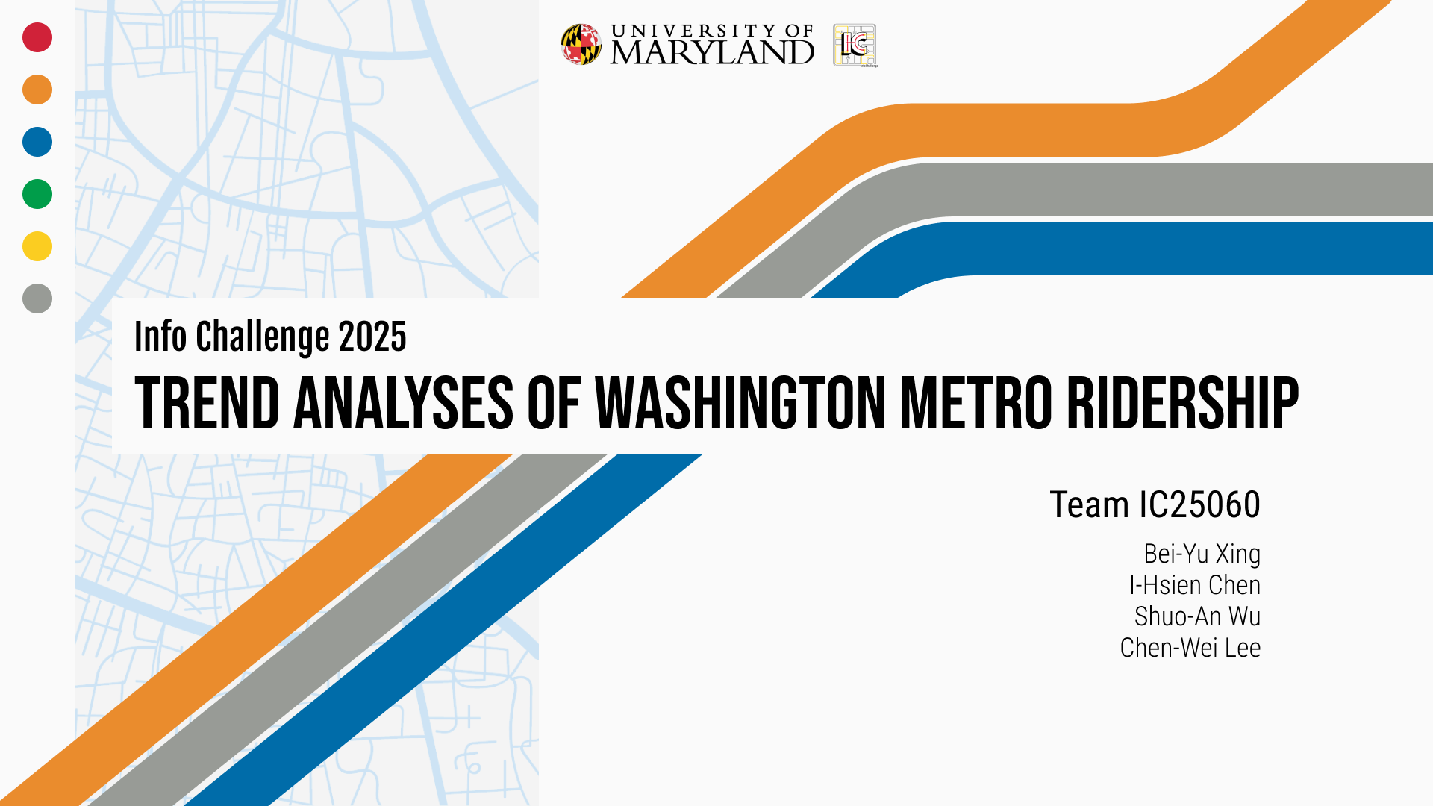

Slide 2
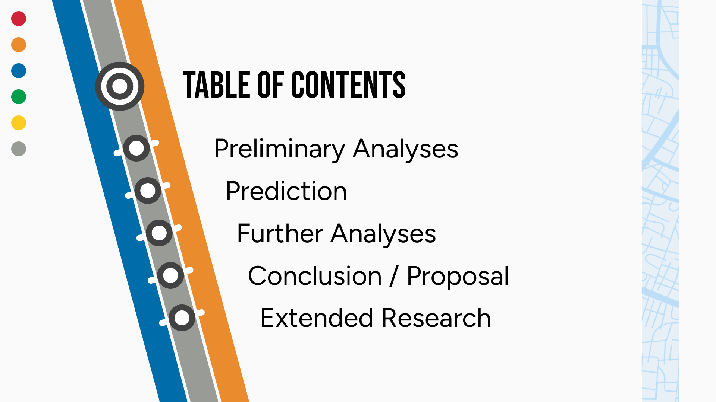
Notes:
GOAL (不放)
PRELIMINARY ANALYSES – Focus on DC Metro
PREDICTION – Ridership & Weather
FURTHER ANALYSES – Cross-city comparison
CONCLUSION / PROPOSAL
EXTENDED RESEARCH

Slide 3

PRELIMINARY ANALYSES
Notes:
Zoom out: from one month to twelve years
1. Single month 2024/5 (a normal month w/o special days)
2. Single year 2024 (each line is one month)
3. 2024 daily entries
4. 2020 - present monthly total entry -> Oct always the highest
5. 2012 - present monthly total entry
2012 - 2024 October
6. Compare monthly average to the October entries (after COVID)
7. Compare entry between weekend and weekday in October
8. Compare entry between weekend and weekday in Whole Year
9. Compare 7 and 8

Slide 4

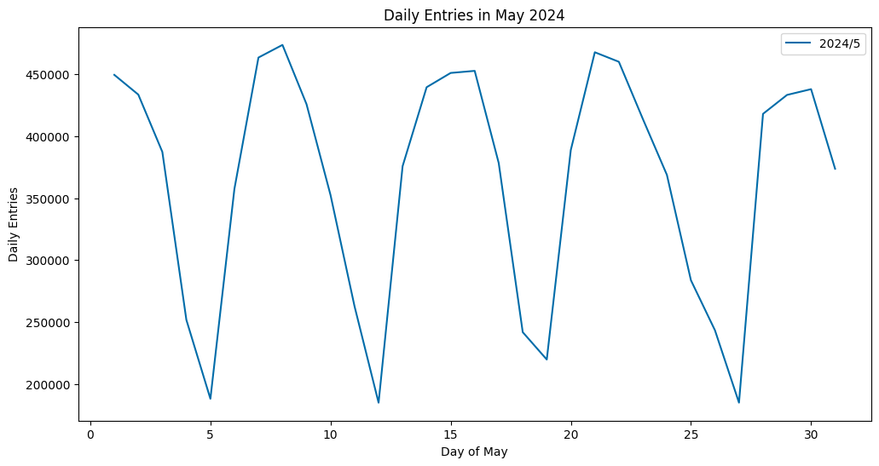

PRELIMINARY ANALYSES
Daily Trend of Ridership (May 2024)
Notes:
Single month 2024/5
Select a normal month w/o important holidays or extreme climate
Find the periodicity in weeks

Slide 5
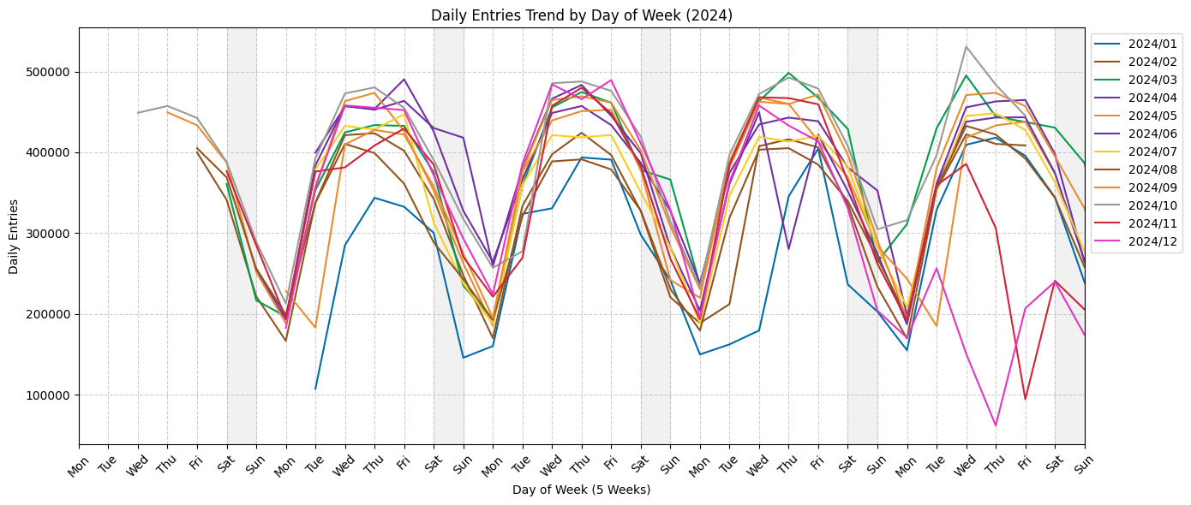
PRELIMINARY ANALYSES
Daily Trend by Day of Week (2024)
Notes:
Single year 2024 (each line is one month)
Check whether this periodicity in weeks is similar in each month
-> Yes

Slide 6
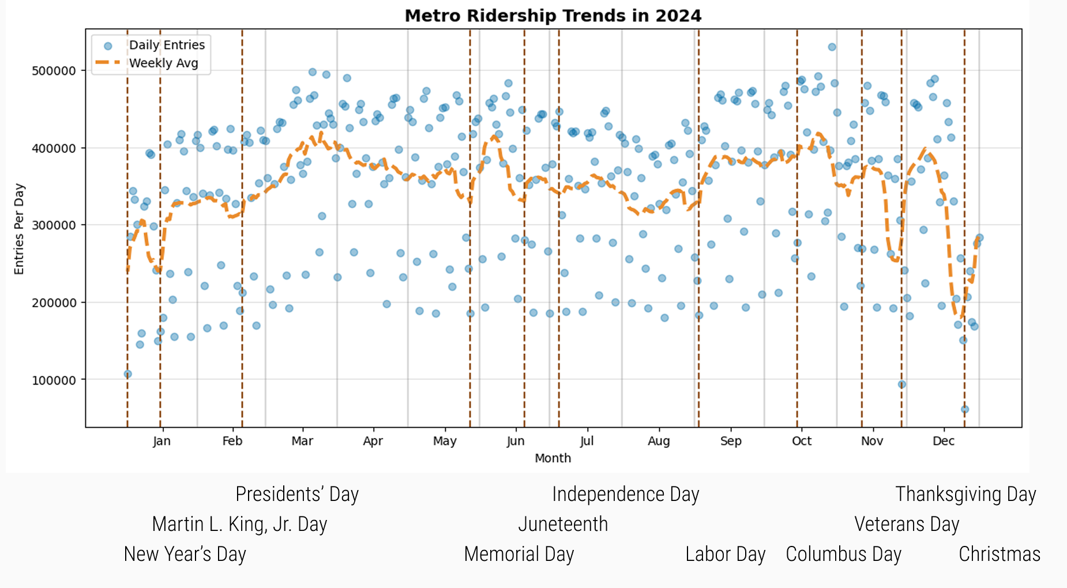
PRELIMINARY ANALYSES
Ridership Trends (2024)
Notes:
2024 daily entries
Holidays usually cause lower riderships
High peak in Spring and Fall
'2024-01-01': 'New Year's Day',
'2024-01-15': 'Martin Luther King, Jr. Day',
'2024-02-19': 'Washington’s Birthday (Presidents’ Day)',
'2024-05-27': 'Memorial Day',
'2024-06-19': 'Juneteenth National Independence Day',
'2024-07-04': 'Independence Day',
'2024-09-02': 'Labor Day',
'2024-10-14': 'Columbus Day (Indigenous Peoples’ Day)',
'2024-11-11': 'Veterans Day',
'2024-11-28': 'Thanksgiving Day',
'2024-12-25': 'Christmas Day'

Slide 7
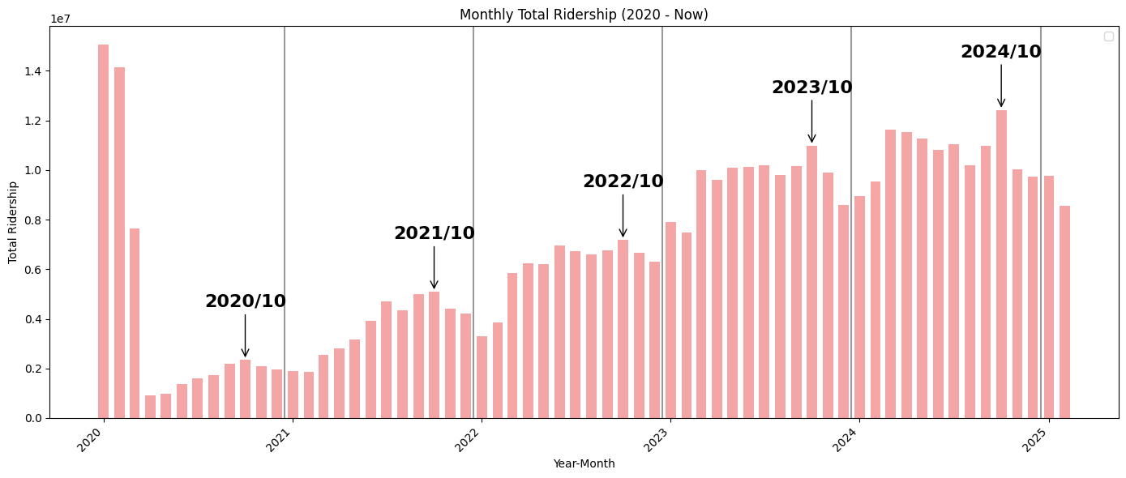
PRELIMINARY ANALYSES
Ridership Trends (2020/1 - Now)
Notes:
2020 - present monthly total entry
-> Oct always the highest
Why?

Slide 8
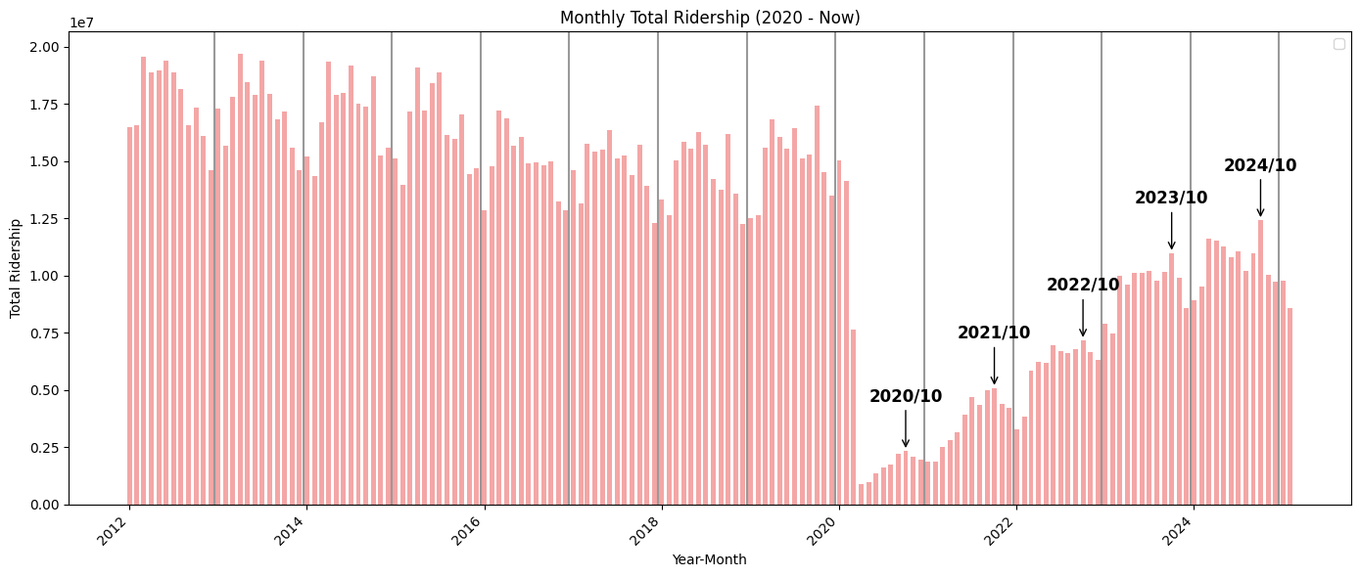
PRELIMINARY ANALYSES
Ridership Trends (2012 - Now)
Notes:
2012 - present monthly total entry
In 2012/1 - 2020/3 (Before COVID outbreak)
Yearly high peak was Spring
In 2020/4 - 2024/12 (After COVID outbreak)
Yearly high peak was October
-> Pattern changed after COVID outbreak

Slide 9

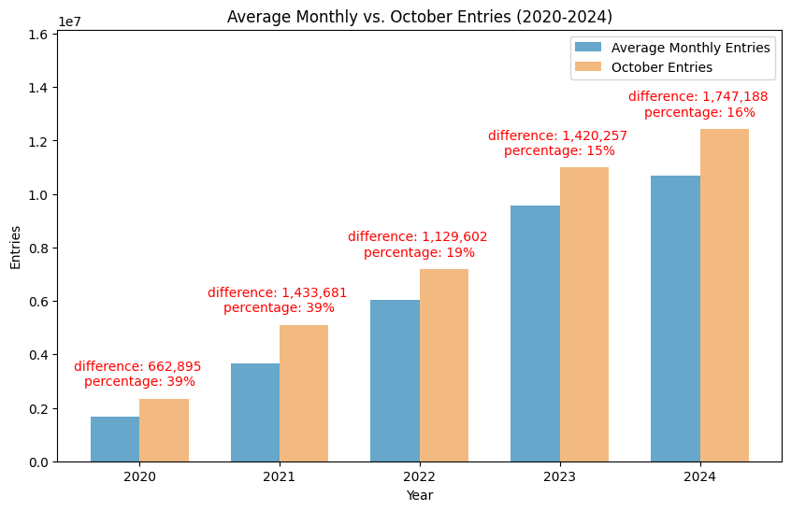
PRELIMINARY ANALYSES
Comparison: Monthly Average v.s. Oct.
Notes:
Compare monthly average to the October entries (after COVID)

Slide 10
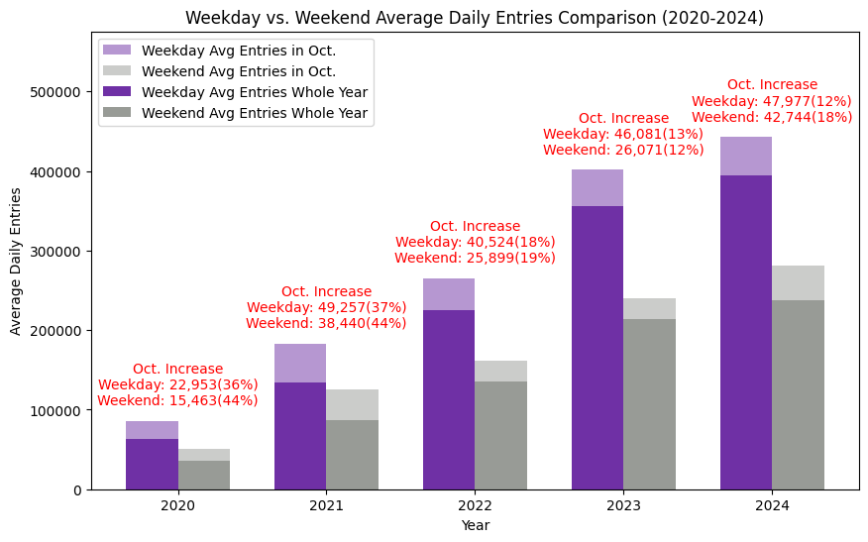
PRELIMINARY ANALYSES
Comparison: Weekday v.s. Weekend
Notes:
The reason Oct. has the highest ridership:
Guess: Increased commuting population
Compare:
Oct. Daily Avg weekday vs weekend
Whole year Daily Avg weekday vs weekend
Conclude:
Difference didn't increase significantly -> commuting population is not the only reason
Both weekday and weekend daily ridership increased in October

Slide 11




PRELIMINARY ANALYSES
Possible Reasons
Climate impact
Peak season for tourism and activities
Increased work and government activities
Back-to-school season and school year activities
Notes:
Possible Reasons:
1. Climate impact: October is cool, suitable for walking and public transportation
2. Peak season for tourism and activities
Autumn tourism peak
Annual events and festivals
3. Increased work and government activities -> weekday commuting
The new fiscal year of the U.S. federal government begins on October 1:
Many government agencies and companies will have more meetings, reports and activities during this period, increasing the commuting needs of office workers.
Policies and political activities:
As a political center, DC may have various policy announcements, congressional meetings, marches and demonstrations every October, which may affect subway passenger flow.
4. Back-to-school season and school year activities
Stabilization period after the start of university
Extracurricular teaching for primary and secondary schools

Slide 12
Prediction
Notes:
Explore the features:
Create Correlation matrix to explore relation between features
Feature Engineering and Selection:
Lag Features: Previous day’s ridership
Rolling Features: 7-day average to capture trends
Interaction Features: Combining Holiday & Weekday

Slide 13
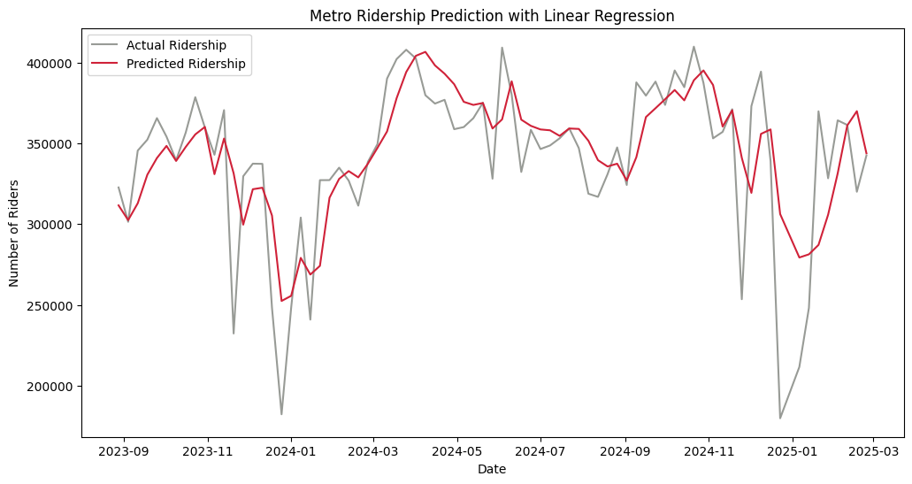
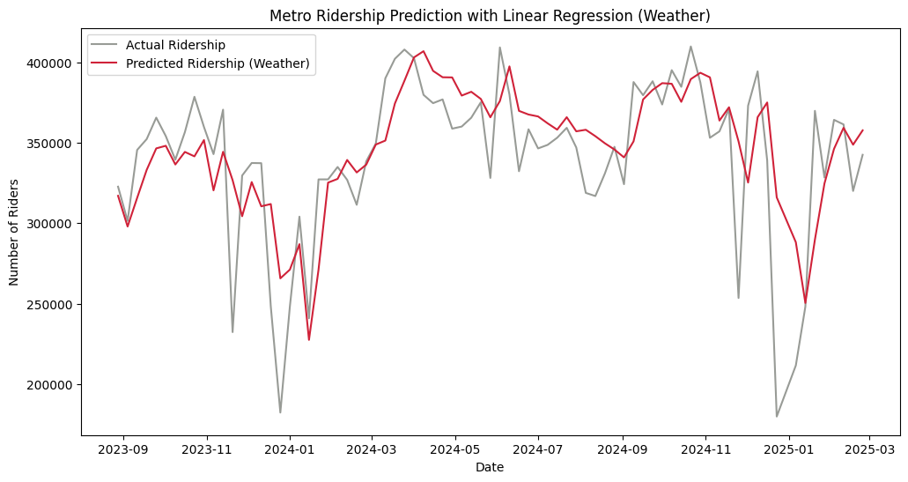
Prediction
Prediction of W. Metro Ridership:
Based on Ridership & Weather Data
Ridership Data only
Ridership & Weather Data
R² = 0.53
R² = 0.50
Notes:
Model used: Polynomial, Ridge, Lasso Regression, Random Forest Regressor, a model for time series (ARIMA (Autoregressive Integrated Moving Average))
Best Model: Linear regression, but still not good at predicting the sudden drops (Christmas to New Years break)
Ridership Data only
MAE: 23131.63
RMSE: 33526.01
R-squared: 0.53
Ridership & Weather Data
MAE: 24273.36
RMSE: 34856.27
R-squared: 0.50

Slide 14
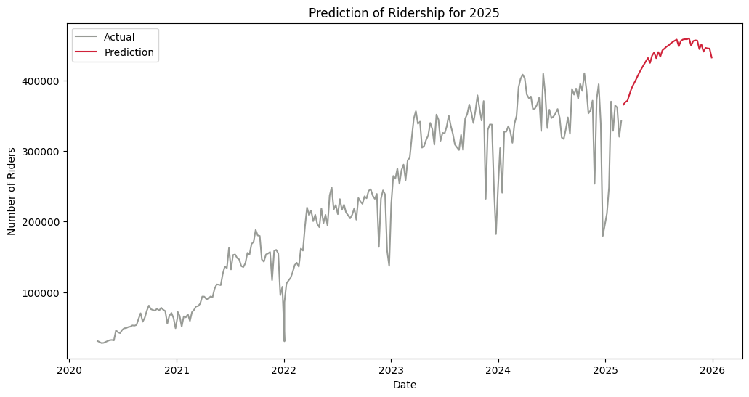
Prediction
Prediction of W. Metro Ridership: 2025
Notes:
This is Prediction for the whole 2025.
Generally follows the trend that ridership increase in spring and summer,
and decrease close to the end of the year.
However, not good at the sudden drops, we would expect the ridership around Christmas to be lower.

Slide 15
FURTHER ANALYSES
Notes:
For further analysis, we want to compare Washington Metropolitan ridership with other rail agency in the U.S.

Slide 16
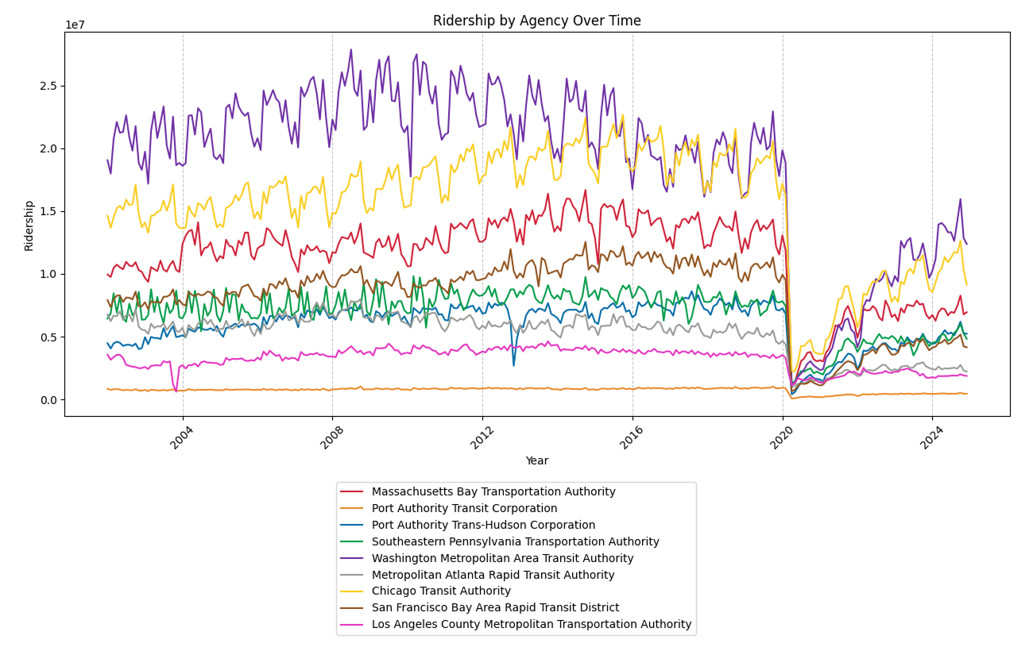
FURTHER ANALYSES
Compare Ridership Growth Since 2002 Against Other Rail Agencies
Notes:
Data source: Federal Transit Administration, Complete Monthly Ridership from 2002 to 2024 for 9 large rail agencies in the U.S.
First, we can see that there is a huge drop in 2020, which is the pandemic.
Second, Washington Metropolitan is on the top throughout the years.
Although Washington drop to top3 after the pandemic, it still returned to the highest among other agencies in 2023.

Slide 17
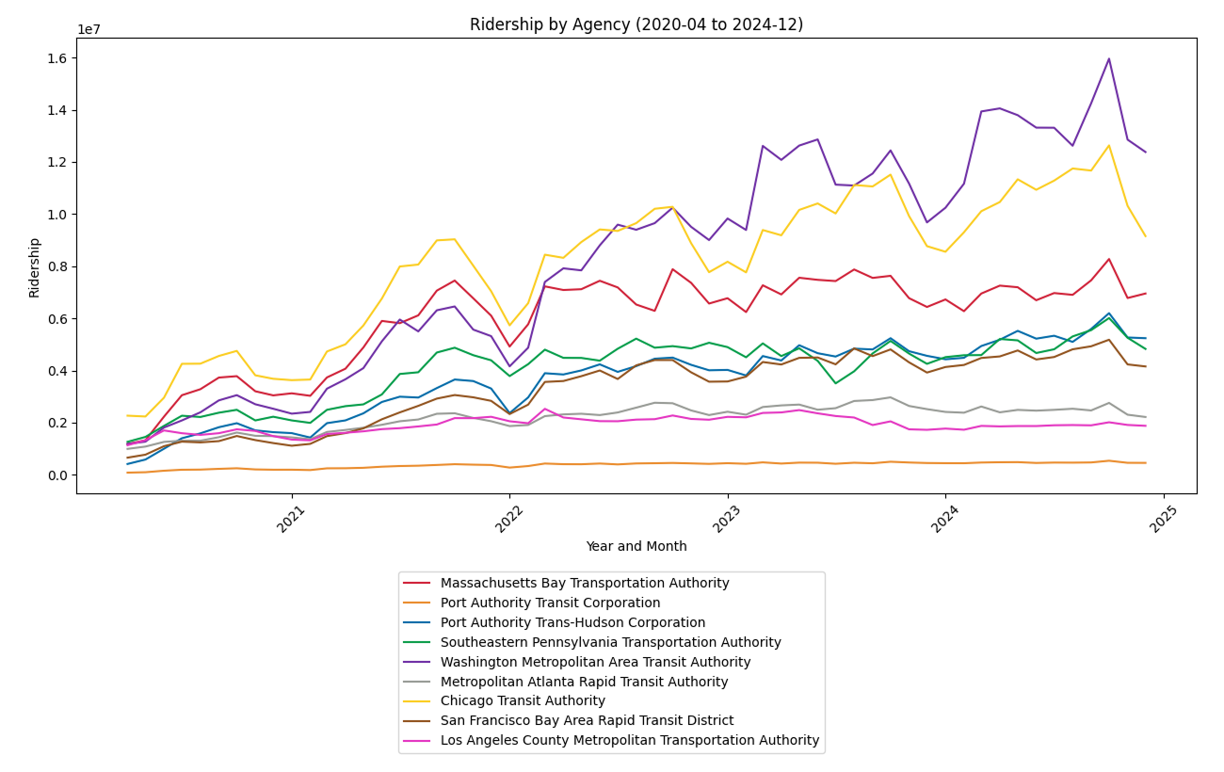
FURTHER ANALYSES
Compare Ridership Growth Post-pandemic
Notes:
Now we zoom in to the post-pandemic years, there is a positive growth for half of the agencies.
And most agencies show a strong rebound trend in 2024.
So we want to further investigate their recovery rate.

Slide 18
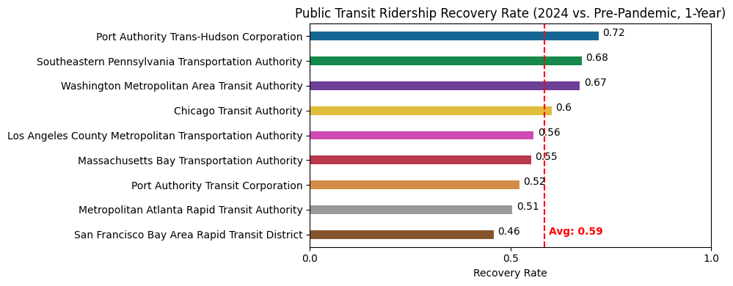
FURTHER ANALYSES
Compare Ridership Recovery Rate
Notes:
For the calculation of recovery rate, we first take a year prior to the pandemic as our baseline and use the average ridership for 2024 as the numerator.
The average recovery rate is 0.59, meaning that almost every agencies have a good recovery after the pandemic.
And it turns out that PATH and SEPTA has slightly higher recovery rate than WMATA.

Slide 19
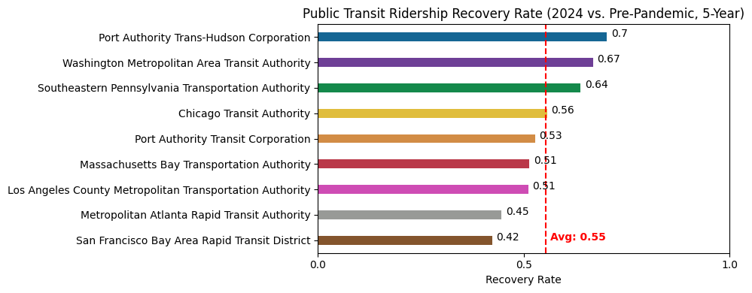
FURTHER ANALYSES
Compare Ridership Recovery Rate(Cont'd)
Notes:
Now we take 5 years prior to the pandemic as our baseline and use the same average as the numerator.
The average recovery rate decline to 0.55. Because the five-year average gives a more stable historical reference, showing that while 2024 has recovered, it’s still not quite back to the pre-pandemic long-term average.
And for this version of recovery rate, PATH still has a better recovery rate than WMATA and is the highest rate among all the agencies.

Slide 20




FURTHER ANALYSES
Reasons for Higher Recovery Rate
Economic recovery
Improvements in operations and services
Geographic and transportation hub advantages
Policy and financial support
Notes:
After the pandemic, the economy in the New York and New Jersey areas is slowly bouncing back. Many commuters are now returning to the office, which has helped increase the ridership on the PATH system.
To face the challenges from the pandemic, the Port Authority introduced measures to improve efficiency and the passenger experience, like more frequent trains and extra cleaning and safety protocols. These steps have helped boost passengers' confidence in the service.
The PATH system connects New York City and New Jersey, serving as a key commuting link between the two. Since it's such an important part of the area's transportation network, it maintains steady passenger flow, even during special situations.
Government funding and support for public transportation have provided solid backing for PATH's recovery, helping it return to pre-pandemic service levels more quickly.

Slide 21
CONCLUSION / PROPOSAL

Slide 22
CONCLUSION / PROPOSAL
Focus on commuters:
Improve experience for commuters: increase frequency of rides in peak hours
Fare adjustments: Monthly Pass
Focus on tourist:
Promote 1, 3, 7-day Unlimited Pass
DC Event Pass with special events in DC
Suggestion:
Collect data regarding ratio of visitors vs residents using the metro
Notes:
Focus on commuters:
Improve experience for commuters, eg: increase frequency of rides in peak hours
Fare adjustments: Monthly Pass: like subscription to Netflix, gain advantages, Stable cash flow
Focus on tourist:
Promote 1, 3, 7-day Unlimited Pass in tourist season, like March, April, October
DC Event Pass, collaborate with special events in DC, eg: Ball games, Zoolight, Festivals
Also helps with traffic in those busy times.

Slide 23
EXTENDED RESEARCH

Slide 24


Extended Research
Moving Forward
Period
Hourly
Line
Region
Station
Notes:
Deepen and Refine

Slide 25
Data Sources
Federal Transit Administration https://www.transit.dot.gov/ntd/data-product/monthly-module-adjusted-data-release
Weather API by Visual Crossing
https://www.visualcrossing.com/weather-api/

Slide 26


